Slide 1
One SPCA
Regional Meetings
Friday 28 April 2017 (Auckland)
Saturday 29 April 2017 (Wellington)
Sunday 30 April 2017 (Christchurch)

Slide 2
Contents
Agenda
Welcome & Introduction
Constitution and related documents: re-cap
Transition & Transfer: The 7 Steps
Staff consultation and transfer process
Finance and IT – update
Open Forum – Feedback & Q&As
Preparation for Smooth Transfer (subject to the vote at the AGM in June 2017)
Thank you & Close

Slide 3


Proposed Constitution & Related Documents: Re-cap Maria Clarke, Legal Adviser

Slide 4
Recap of the ‘One SPCA’ Proposal
One legal entity – RNZSPCA (working name – SPCA)
One vision, one strategy, one voice for the animals
Each Centre’s assets/liabilities transferred into SPCA
Centre legal entities cease to exist
All staff (other than a few who will be appointed into new roles) will continue in the same position on the same employment terms, but with SPCA as their employer
All volunteers also transfer to SPCA, if they wish
Local Supporter Groups established to engage with communities and drive fundraising at a local level
One Board, and for a transition period of three years, Regional Sub-Committees of the Board

Slide 5
RNZSPCA to One SPCA Entity
RNZSPCA Incorporated
RNZSPCA Incorporated trading as “SPCA”
Current Constitution
New Constitution

Slide 6

RNZSPCA AGM - Vote
At June 2017 AGM each Centre will vote for or against:
new Constitution
*Transition Regulations
*revised Branch rules
There will be one motion put to adopt them all and revoke the current constitution
If a two-thirds vote in favour, this will give life to the new ‘One SPCA’ organisation.
* Only apply for Transition period

Slide 7
Proposed Constitution
Name, Status, Purpose, Powers
Membership – categories, rights, obligations
Governance – Patron, Board, Board Appointments Panel, powers, duties, CEO
General meetings – notice, agenda, voting, urgent resolutions
Financial – financial year, reporting, audits
Other matters - alterations of Constitution, regulations, indemnities, dissolution
Transition – transition/inaugural Board, transfer to SPCA, consequences of not transferring

Slide 8
Membership
Two categories:
- Full Members - individuals including current members of Centres (if choose), volunteers, public, others
- Life Members - exceptional service or contribution (including existing Centre and RNZSPCA Honorary and Life Members)
Standard fee, e.g. $40 p.a. (unless Life Member); fee waived until 30 June 2019
Right to vote – each member = one vote
Right to be members of Local Supporter Groups
Must be a Member to be on the Board or Regional Sub-Committee

Slide 9
RNZSPCA Board Transition
Inaugural Board – as appointed by Board Appointments Panel
Transition Board – as elected at June AGM
Existing Board
Ongoing Board

Slide 10

Transition
All Centres have choice whether or not to transfer in to ‘One SPCA’ entity
Must decide whether to transfer in by 31 July
Must have completed transfer by 31 October
“Transfer” involves all assets, liabilities and staff
Assets (some or all) can be tagged for Centre (for either general or specific use) if agreed
Day 1 of new organisation - 1 November 2017
Process of decision and transfer begins after AGM – 7 steps set out in Transition Regulations

Slide 11
Consequences of Not Transferring
If a Centre does not Transfer by due date:
Keep their assets/liabilities
Not able to operate as an SPCA
Not able to use SPCA name, trade marks or intellectual property
Not able to hold an inspectorate warrant
Cease to be a member of RNZSPCA
Risk that bequests lapse as no longer operating as an SPCA
Centre staff would not be offered transfer to SPCA

Slide 12
Proposed Transition Regulations
Regional Sub-Committees & Review
Local Supporter Groups
Process of Transfer – 7 steps – covered in next section
1. decide intent to transfer at SGM/AGM
2. sign Agreement
3. satisfy Agreement including disclosure
4. SGM to formally decide transfer and dissolution
5. transfer staff
6. transfer assets & liabilities including signing all documentation
7. complete dissolution
Centres under administration/assimilated
Related entities

Slide 13

Local Supporter Groups & Regional Sub-Committees
Local Supporter Groups (LSGs)
Support Centres with local community engagement and fundraising
Any member can be on LSG
Elects own Chair
Meets regularly
Has a ‘voice’ via the Regional Sub-Committee
Regional Sub-Committees (RSCs)
LSGs in each Area nominate their representative on the RSC
Work together to support all Centres in that Region
Has a ‘voice’ on the Board – Chair of RSC is a Board member
Regional Sub-Committee structure to be reviewed after 2 years (for decision in 2020)

Slide 14
Proposed Revised Branch Rules
Revised Branch rules must be ratified by Branches and filed with Registrar
Only apply for transition period until dissolve
Proposed revised Branch rules:
Clarifies process for calling a SGM
Enables second SGM if quorum not reached at first
Rewording of dissolution provision
If Branch does not adopt them, then existing Branch Rules apply

Slide 15

Transition & Transfer: The 7 Steps Maria Clarke, Legal Adviser

Slide 16
Timeline (see A3 Sheet)
One SPCA Timeline and Key Dates: June to October 2017
Week ending |  | 9-Jun | 16-Jun | 23-Jun | 30-Jun | 7-Jul | 14-Jul | 21-Jul | 28-Jul | 4-Aug | 11-Aug | 18-Aug | 25-Aug | 1-Sep | 8-Sep | 15-Sep | 22-Sep | 29-Sep | 6-Oct | 13-Oct | 20-Oct | 27-Oct | 3-Nov
Legal/ Commercial | AGM/SGM | Notice of SGM 1 (subject to Constitution being adopted at RNZSPCA AGM) |  | 17 June - RNZSPCA AGM | STEP 1: SGM 1 - resolve intention to join, adopt Branch rules, decisions on Agreement |  |  |  |  |  |  |  | Notice of SGM 2 |  | STEP 4: SGM 2 - resolve to join and transfer assets, liabilities and staff |  |  |  |  | STEP 4: SGM 3 - only for Centres that liquidate rather than dissolve
 | Agreement/ Disclosure |  |  |  | STEP 2: Enter into Agreement with RNZSPCA (latest 31 July) | STEP 3: Satisfy the Agreement (Steps 3 - 7) including (STEP 6) providing RNZSPCA with required information and transferring assets, liabilities, etc.
 |  |  |  |  |  | Disclosure - all assets, liabilities, staff documents disclosed to RNZSPCA by 4 August
 | Transfer/ Sign Docs. |  |  |  |  |  |  |  |  | Prepare SGM resolutions & documents |  |  |  |  | Sign all documents |  |  |  |  |  |  |  | STEP 7: 31 October: Final Transfer Date; Liquidate/ Dissolve
People (Note: all information will be treated in strictest confidence and only accessible to approved individuals) | Consult |  |  |  | STEP 5: Centres consult with staff (subject to joining) | Staff submit feedback | Feedback analysed and changes made based on feedback | Org. structure confmd.
 | Disclose/ Transfer |  |  |  |  | STEP 3: Centres provide all staff information to RNZSPCA (subject to joining) |  |  | Prepare docs. for employee transfer (offers) |  |  |  |  |  |  | STEP 5: Written offers made to staff (within 10 days of SGM 2); offers accepted/declined (within 10 days of written offers); transfer staff to RNZSPCA. Data entered into payroll system
 | Recruit/ Appoint (New Roles) |  |  |  |  |  |  |  |  | Recruitment/Appointment - all new roles, e.g. Area Managers

Slide 17
Transfer - The 7 Steps
Each Centre is required to complete the following steps:
Decide if intend to Transfer and adopt revised Branch Rules
If Transferring, sign Agreement with RNZSPCA
Satisfy the agreement
Make final decision to join ‘One SPCA’ entity
Transfer staff
Transfer assets and liabilities including signing all documentation
Complete liquidation or dissolution

Slide 18

Step 1
Decide if Intend to Transfer and Adopt Branch Rules
After RNZSPCA AGM and before 31 July (6 weeks)
Call SGM 1 (SGM requires 14 days notice)
Need 10 members for quorum (paid up 3 months prior)
Intention not binding but enables next
steps to be undertaken
If a Branch, adopt Revised Branch Rules

Slide 19

Step 2
Enter into Agreement with RNZSPCA
To be completed by 31 July
Record intent to transfer
Agreement to disclose assets/liabilities, contracts, employment terms and other documents and agree the process
Agreed timeline, e.g. date(s) of SGM(s)
Agreed process for consultation with staff
Proposed terms of transfer, e.g. specific tagging

Slide 20

Step 3
Satisfy the Agreement
Complete disclosure of all assets/liabilities
including documentation by agreed date
Comply with timelines as agreed in Step 2
Undertake agreed process for consultation with staff
Complete all steps by due dates unless the RNZSPCA Board, in its discretion, grants a change to the dates - which it may do in exceptional circumstances on a case-by-case basis.

Slide 21


Step 4
Resolve to join One SPCA entity - Members vote at SGM 2
Hold SGM 2 (need quorum)
Resolve to:
Transfer into ‘One SPCA’ entity
Dissolve or be Liquidated
Will need to hold another SGM (SGM 3) if being
liquidated (also note extra costs)

Slide 22
Liquidation vs Dissolution
Liquidation
Requires 2 SGMs of members, at least 30 days apart
Dissolution
Decision made by Registrar of Incorporated Societies if legal entity is no longer operating
Decision made by Members
SPCA can apply for dissolution in due course
One SGM sufficient
Must appoint liquidator

Slide 23

Step 5
Transfer Staff
Refer to section on Staff Consultation & Transfer Process for details

Slide 24

Step 6
Transfer Assets and Liabilities
Enter a Deed of Gift to transfer Assets
with effect 1 November 2017
Enter into others deeds, agreements
and other documents as are necessary to transfer Liabilities
Complete all other documentation,
authorities and consents, to give effect to
the Transfer

Slide 25
Step 7
Complete liquidation or dissolution
If liquidation:
liquidator completes the steps
If dissolution:
application to Registrar
evidence that entity is “no longer carrying on operations”
can be filed by SPCA

Slide 26
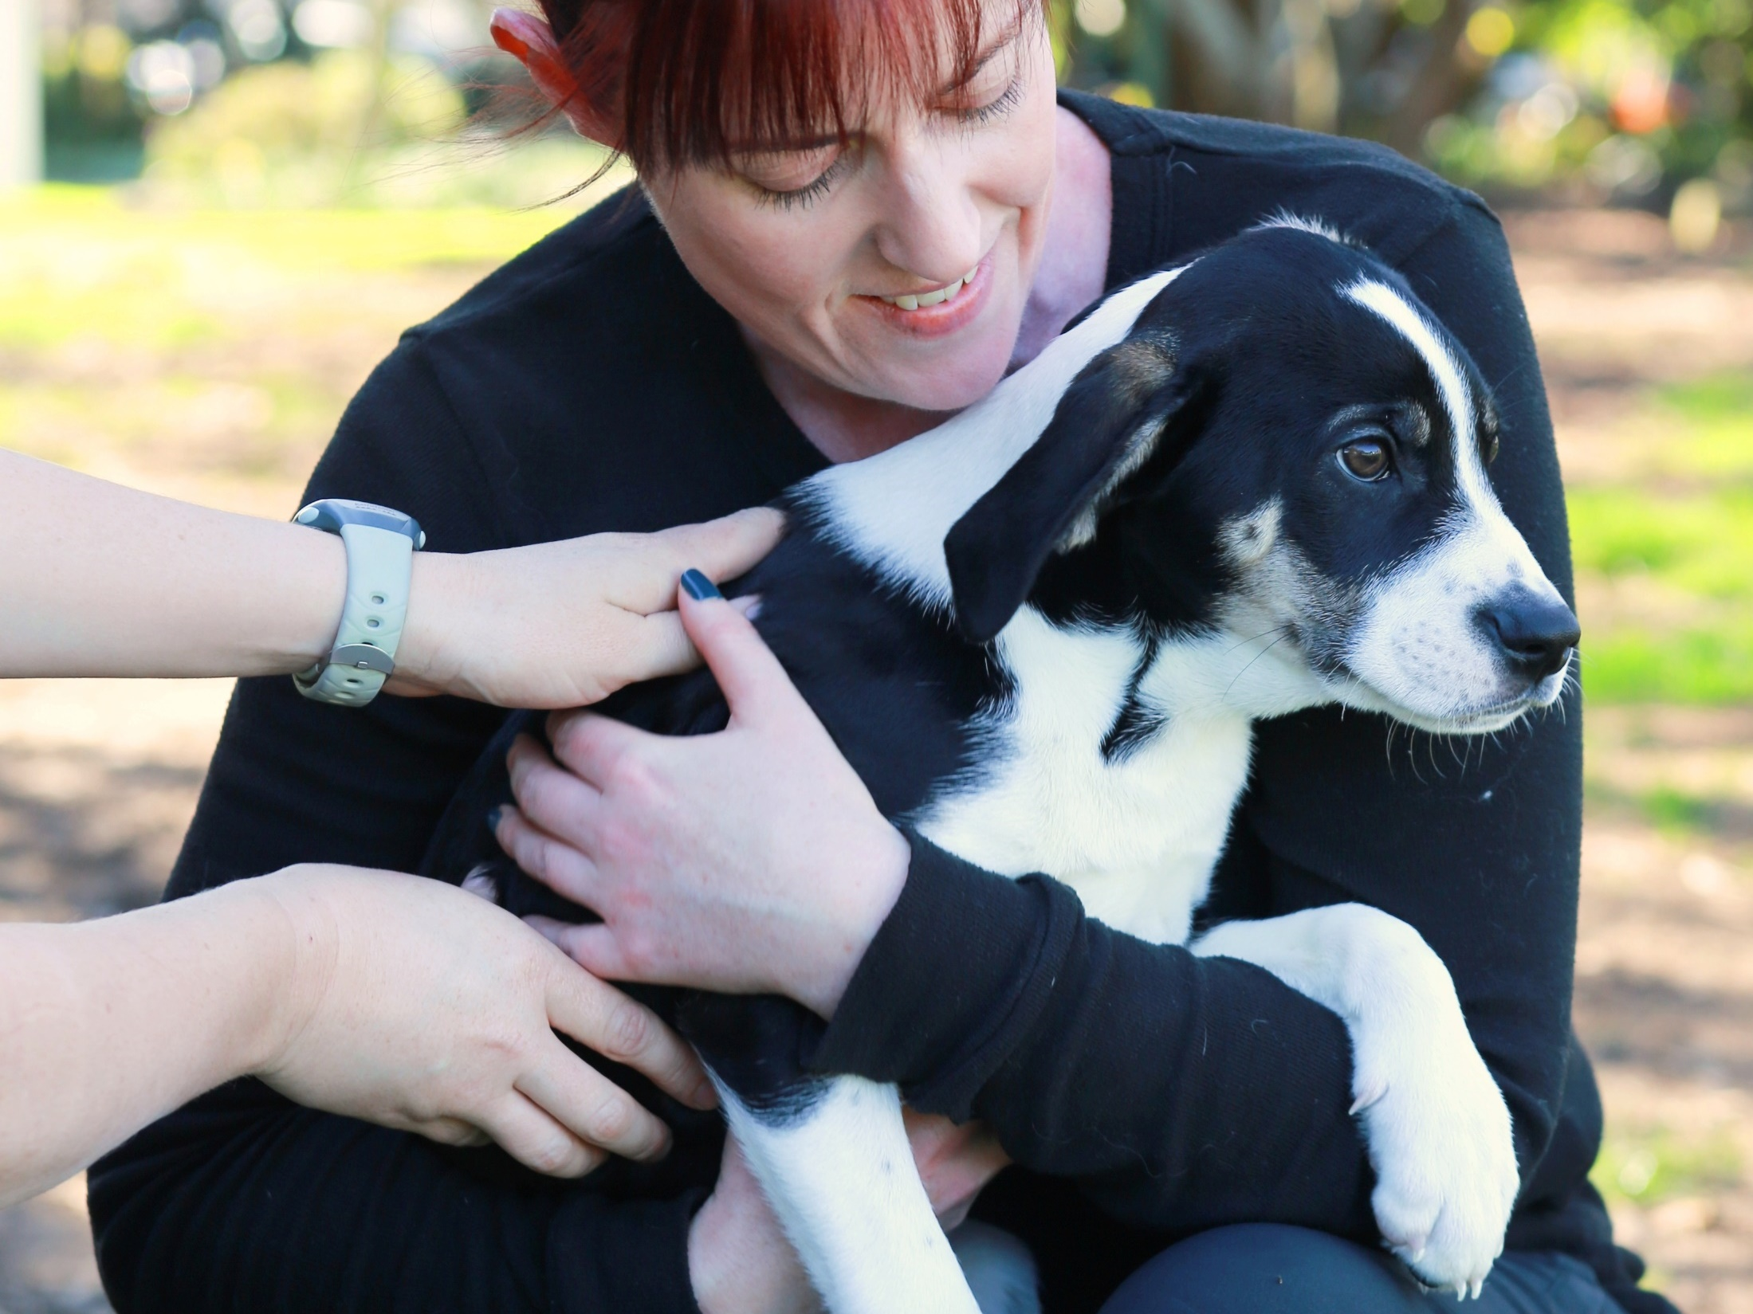
Staff Consultation and Transfer Process Kira Schaffler, Project Manager WTAO

Slide 27
Timeline (see A3 Sheet)
One SPCA Timeline and Key Dates: June to October 2017
Week ending |  | 9-Jun | 16-Jun | 23-Jun | 30-Jun | 7-Jul | 14-Jul | 21-Jul | 28-Jul | 4-Aug | 11-Aug | 18-Aug | 25-Aug | 1-Sep | 8-Sep | 15-Sep | 22-Sep | 29-Sep | 6-Oct | 13-Oct | 20-Oct | 27-Oct | 3-Nov
Legal/ Commercial | AGM/SGM | Notice of SGM 1 (subject to Constitution being adopted at RNZSPCA AGM) |  | 17 June - RNZSPCA AGM | STEP 1: SGM 1 - resolve intention to join, adopt Branch rules, decisions on Agreement |  |  |  |  |  |  |  | Notice of SGM 2 |  | STEP 4: SGM 2 - resolve to join and transfer assets, liabilities and staff |  |  |  |  | STEP 4: SGM 3 - only for Centres that liquidate rather than dissolve
 | Agreement/ Disclosure |  |  |  | STEP 2: Enter into Agreement with RNZSPCA (latest 31 July) | STEP 3: Satisfy the Agreement (Steps 3 - 7) including (STEP 6) providing RNZSPCA with required information and transferring assets, liabilities, etc.
 |  |  |  |  |  | Disclosure - all assets, liabilities, staff documents disclosed to RNZSPCA by 4 August
 | Transfer/ Sign Docs. |  |  |  |  |  |  |  |  | Prepare SGM resolutions & documents |  |  |  |  | Sign all documents |  |  |  |  |  |  |  | STEP 7: 31 October: Final Transfer Date; Liquidate/ Dissolve
People (Note: all information will be treated in strictest confidence and only accessible to approved individuals) | Consult |  |  |  | STEP 5: Centres consult with staff (subject to joining) | Staff submit feedback | Feedback analysed and changes made based on feedback | Org. structure confmd.
 | Disclose/ Transfer |  |  |  |  | STEP 3: Centres provide all staff information to RNZSPCA (subject to joining) |  |  | Prepare docs. for employee transfer (offers) |  |  |  |  |  |  | STEP 5: Written offers made to staff (within 10 days of SGM 2); offers accepted/declined (within 10 days of written offers); transfer staff to RNZSPCA. Data entered into payroll system
 | Recruit/ Appoint (New Roles) |  |  |  |  |  |  |  |  | Recruitment/Appointment - all new roles, e.g. Area Managers

Slide 28
Draft Area Groupings (includes all current SPCA Centres)
Northern |  | Central |  | Southern
Area |  | Area |  | Area
N1 | Kaitaia & Districts Bay of Islands Whangarei | C1 | Manawatu Wanganui Feilding and Districts North Taranaki South Taranaki Horowhenua | S1 | Marlborough Golden Bay Motueka Nelson
N2 | Thames Waihi Tauranga Whakatane Kawerau Opotiki | C2 | Gisborne Hawkes Bay Hastings & Districts Central Hawkes Bay Dannevirke | S2 | Mid Canterbury South Canterbury Hokitika Greymouth Buller
N3 | Waikato South Waikato Rotorua Taupo Turangi Te Kuiti Central King Country | C3 | Wellington Wairarapa Upper Hutt | S3 | North Otago Otago Gore & Districts Southland
N4 | Auckland Waiheke Island |  |  | S4 | Christchurch

Slide 29
Volunteers
Volunteers are, and would continue to be, recognised as valued members of the team
Volunteers do not legally have to be consulted
Their feedback is welcome
Volunteers will transfer into the SPCA, if they wish
Continue to provide services in the Centres, doing the same jobs they do today

Slide 30
Staff Consultation & Transfer
Employers must consult on proposed changes with “potentially impacted” staff
All staff are “potentially impacted” – change of employer plus (in some cases) organisation structure changes
Following consultation process (including feedback) organisation structure will be confirmed
Once this and SGM 2 (Step 4: Resolve to Join) are completed then staff can be transferred

Slide 31
Staff Consultation & Transfer
Transfer process:
all current staff receive an offer: either Letter of Transfer or a new Individual Employment Agreement
must be signed by 15 October, latest
all employees required to sign-up to SPCA’s Code of Conduct, and core policies, e.g. Health & Safety, Media, etc.
Offer on no less favourable terms
However may:
report to a different position
be offered another position (can accept or decline)

Slide 32

Finance & IT – update Alan Brame, CFO

Slide 33
What are we doing now?
Considering finance & payroll systems
understanding current state
determining our needs
considering options
2. Involving the “virtual” finance team for support and advice
3. Assisting Centres
4. Supporting the WTAO project
5. Preparing budget for ‘One SPCA’ entity
6. Reviewing financial policies and procedures
7. Considering banks

Slide 34
Recommendations to-date
Finance will be centralised (although team may be based in different Centres)
One “source of the truth” - data entered once
Payroll managed centrally
Centres have access to “funds” to pay local expenses
Supplier invoices approved in line with agreed limits by Centre/Area/Regional Manager and processed centrally
One main bank a/c, but may need more than one bank a/c
List of tagged assets to be managed and maintained
Budget:
will be built up through Centre, Area, Region
initial expenditure in line with previous years and Centre’s needs
separate budget for asset purchases

Slide 36

“Jump on in”
We’re here to help!

Slide 37

Preparation for Smooth Transfer (subject to the vote at the AGM in June 2017): Andrea Midgen

Slide 38
Preparation for Smooth Transfer
Subject to vote in favour at AGM in June
Also pre-supposes that your Centre is planning and/or likely to join the ‘One SPCA’ entity
Some activities can be done during the next 6 weeks to prepare for a smooth and timely transfer
Will ensure that all deadlines are met during the Transfer period
The earlier that these activities are done, the easier and smoother the Transfer is likely to be

Slide 39
Checklist: What to do before the AGM on 17 June
No. | What To Do | √
1. | Nominate your delegate for the AGM (17 June 2017) and send delegate’s name to RNZSPCA
2. | Nominate attendee(s) for the Next Steps Workshop (Sunday 18 June). Recommend Centre Manager and/or person accountable for managing the Transfer process and accessing Centre information
3. | Book flights and accommodation for AGM/Next Steps Workshop attendees
4. | Engage Centre members as required to ensure sufficient numbers for upcoming SGMs (quorum requires 10 members paid-up 3 months prior)
5. | Schedule SGM 1 for early July (see Timeline); send out notice of SGM 1 (at least 14 days prior). Refer to Rule B17 of Branch Rules for more detail on notice of General Meetings
6. | Start to compile a list of all assets and existing contracts and gather supporting documentation
7. | Brief your staff (and volunteers, if appropriate) to keep them up to date with what’s happening and the plan for staff consultation and transfer
8. | Source electronic copies of all staff employment agreements and other relevant employee information.

Slide 40
Support/Assistance
Support will be provided during the transfer process
In the meanwhile, any questions, contact:
Kira Schaffler (kira.schaffler@spca.nz)
or
Jenni Temple (jennifer.temple@spca.nz)

Slide 41
Working Together as One SPCA
Thank you

